Slide 1
The Design of Safety Critical Systems
Functional Decomposition

Slide 2
Functional Decomposition
Requirements -> Function -> Form
Modified from www.stackoverflow.com

Slide 3
Functional Decomposition
Functional Decomposition is the process of taking a complex process and breaking it down into its smaller, simpler parts.
For instance, think about using an ATM. You could decompose the process into:
Walk up to the ATM
Insert your bank card
Enter your pin
4. …………..
Modified from www.stackoverflow.com

Slide 4
Functional Decomposition
a proactive approach to design/programming (resisting the urge to code)
helps identify the complex and/or risk areas of a project
helps identify ALL components of a project
The #1 cause of project/code failure is missing pieces - things not thought of until late in the project
decouples components for distribution of work

Slide 5
Functional Decomposition
You can think of programming the same way.
Code for reading the card
PIN verification
Transfer Processing
Each of which can be broken down further.

Slide 6
Functional Decomposition
Function : General input/output relationship of a product having the purpose of performing an overall task, represented by a black box operation on flows of material, energy, and signal
Sub-function: Part of a product’s overall task
Decomposition
Process: Analysis of the black-box operation on flows corresponding to the overall product function in terms of connected basic operations on basic flows corresponding to the sub-functions: Defines key interfaces
Design
knowledge
base: Archived functional models of products and components that are design solutions to sub-functions

Slide 7
Functional Decomposition
Function : Stop Vehicle
Constraints:
Light Weight
Reliable
Safe

Slide 8
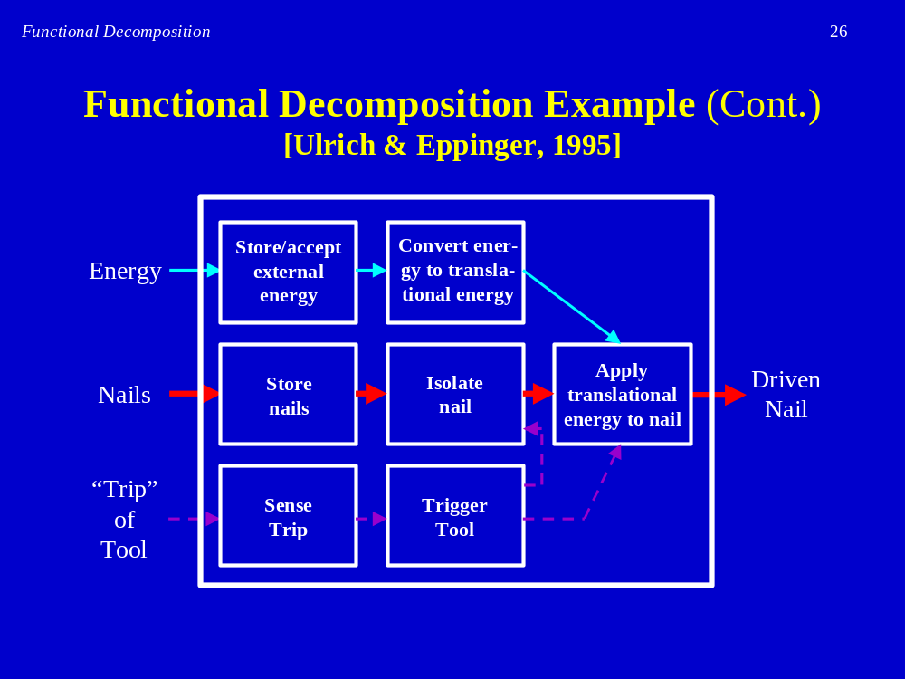
Nail Gun Example

Slide 9
Functional Decomposition
Common Errors:
  not breaking down far enough
  breaking down too far
    - determine the level of detail needed to provide insight to the component
  not using pre-existing designs
  not reviewing with clients to ensure the scope is correct
  not using the breakdown when actually designing

Slide 10
Functionality
Requirements -> Functionality -> Solution
Functionality helps:
Development of hidden requirements
Development of architectures
Identify technologies

Slide 11

Safety Functions
• Can be implemented by independent
protection systems
- e.g. a system that monitors gas leaks in a
chemical plant
• Can be implemented as an integral part of the
main controller or the Equipment under
control (EUC)
- e.g. collision avoidance system for a robot
The Design of Safety Critical Systems
23

Slide 12
FUNCTIONAL SAFETY
• Only part of the safety process
- Not concerned with hazard removal for example
• Starts with a preliminary hazard analysis
• Concerned with a system or equipment with a specific
job to implement a safety role (a safety function)
- Needed to reduce risk to tolerable levels
- If the safety function performs OK the hazardous event will not
take place
The Design of Safety Critical Systems
22

Slide 13
Functional Safety Example
•Interlocked Machinery Guard
A hand guard does not provide functional safety
Guidance for machinery EN ISO 13849-1
Performance Levels vs SILs
Performance Level d.
Probability of dangerous failure per hour 10e-7 - 10e-6
Some equivalence to SIL 2
The Design of Safety Critical Systems
23

Slide 14
Functional Requirements Document
A Functional Requirements document is a textual representation of functional decomposition.
identifies objects.
planning testing.

Slide 15
Task for Thursday
Produce a functional decomposition of the group design

